Slide 1
The heartbeat of entertainment, education and engagement for Hispanics in North Carolina!

Slide 2
WHY RADIO?
*Radio is Targeted
*Radio is Immediate
*Radio is Ubiquous
*Radio Listeners are Loyal
*Radio is Engaging
.
*Radio is Intimate
*Radio has Synergy
*Radio allows for Frequency
*Radio creates Flexibility
*Radio is Cost-Effective

Slide 3
WHY HISPANIC RADIO?
Radio reaches 96% of Hispanic adults 18+ per week
78% of Hispanics use radio as their top device while in their car
90% of Hispanics 18+ consume radio more than any other Spanish-language media
Spanish language radio is a consistent medium across all seasons and all ages
Hispanics tune-in strong to local radio throughout the day for it’s connectability to its’ audience
56% of Hispanics own hearables and 35% of AM/FM listening is using these to listen to radio
Radio is the # 1 way that Hispanics discover new music
Hispanics who are exposed to radio ads produce a greater return on investment then any other demographic group

Slide 4
WHY NORTH CAROLINA?
North Carolina's Hispanic population increased by nearly 40% since 2010. The Hispanic population is now greater than one million people, with 1,118,596 residents according to the 2020 Census.
Statewide, 10.7% of North Carolina’s population is Hispanic or Latino, just over half the national average (18.7%).
The Hispanic population is significantly younger than other North Carolinians, giving your business the opportunity to benefit from “lifetime value”. In 2020, over 1/3 (35.2%) of North Carolina Latinos were under 18, compared to 20.3% of non-Latinos.
Hispanic spending power now exceeds $25 billion in economic impact annually
The last U.S. Census reported over 35,000 Hispanic-owned businesses in North Carolina
Hispanics in North Carolina own homes at a rate of 47.2%, just under the Hispanic national average of 48.1%. With the exponential growth of our Hispanic population in North Carolina, these numbers are only expected to grow!
Among all North Carolina Hispanic or Latino residents, including those born in the United States, 56% identify Mexican as their primary ancestry; 12% identify as Puerto Rican; and another 21% are of a Central American background like Salvadoran, Honduran, and Guatemalan.

Slide 5
WHY LA LEY?
2022 Radio Ink Finalist!
19 years in the making, our 100,000-watt FM station has the largest reach of any Spanish-language radio station between Atlanta and New York
La Ley is part of Curtis Media Group, a major radio broadcast group in the state of North Carolina
La Ley is “LIVE and LOCAL”, every weekday from 5:30 am – 9 pm & on weekends
A Regional Mexican format, La Ley is RELEVANT to the primarily Mexican population in the Designated Market Areas that we reach
Our on-air personalities have anywhere from five to eighteen years of broadcasting on La Ley, making them “local celebrities” and resulting in a trusted following of listeners
La Ley reaches all Central North Carolina, with a population of over half a million Hispanics
Hispanics 12+ listen to online radio an average of 18 hours and 58 minutes per week. La Ley has over 105,000 unique listeners on our La Ley streaming application
75% of La Ley listeners speak both English and Spanish
80% of La Ley listeners prefer to speak Spanish, their love language, and use Spanish-language media to stay connected to their language and culture

Slide 6
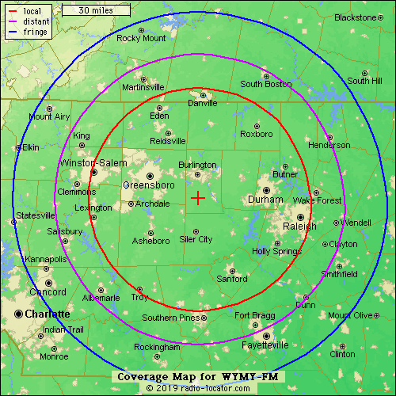
LA LEY REACHES WHERE YOU ARE AND BEYOND! Covering all of Central North Carolina

Slide 7
Our “All Star” Lineup!
5:30 am -9:30 am
WAKE UP WITH ERIC JOHNSON!
8:45 am -10:00 am
YOUR MORNINGS WITH DJ GALLO!
9:45 am – 1:00 pm
MID-DAYS WITH KUY!
12:45 pm – 3:00 pm
MORE WITH DJ GALLO!
2:45 pm – 7:00 pm
AFTERNOONS WITH JULIE GARZA!
7:00 pm – 9:00 pm
INTERNATIONAL MUSIC WITH NABIL VERDUZCO
Saturday and Sunday
WEEKENDS WITH ALFREDO FURMAN & ALMA DAVALOS!
L to R – Cruz, Alfredo, Alma, DJ Gallo, Julie, Eric, Nabil

Slide 8
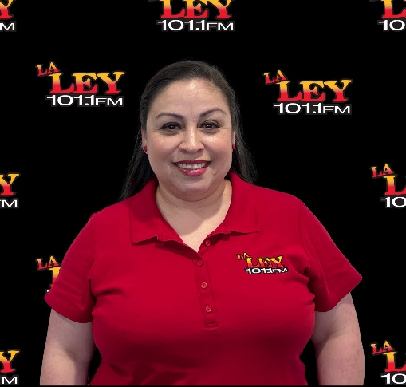
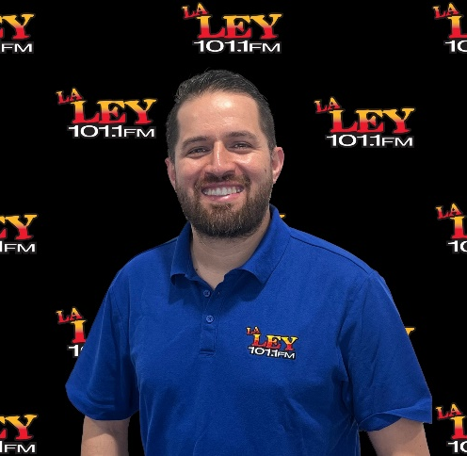
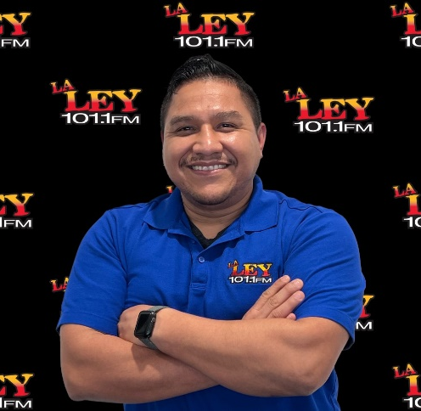
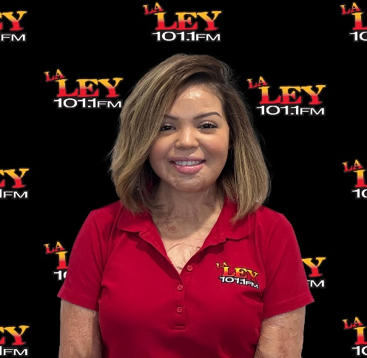
MEET OUR AWARD-WINNING “STARS”!
JULIE GARZA
2022 Radio Ink “Best of the Best” Program Director
2022 Radio Ink Finalist for “Program Director of the Year”
2021 Radio Ink Finalist for “Marketer of the Year”
2017 Radio Ink “Medallas de Cortez” Winner for Outstanding Program Director
2015 Received the Curtis Media President’s Award.
2007 Named Program Director of the Year and Personality of the Year by Monitor Latino
ERIC JOHNSON
2018 Winner of the Curtis Media Group Programming Award for “on-air excellence”!
2016 and 2017 Finalist for the Radio Ink “Medallas de Cortez” Local Personality”
DJ GALLO
2019 Winner of Radio Ink
“Medallas de Cortez”
Local Personality
of the Year!
2018 RadioInk
“Medallas de Cortez” Finalist for
Local Personality of the Year
CRUZ “KUY” SANTIBANEZ
2018 RadioInk Finalist for the
“Medallas de Cortez” Local Personality
of the year!

Slide 9
WE CAN HELP YOU GROW!
DIGITAL
SPONSORSHIPS
SPECIAL EVENTS
COMMUNITY INVOLVEMENT
ENDORSEMENT OPPORTUNITIES
ON-SITE PRESENCE
BANNER ADS
ONLINE RADIO
JOB FAIRS
PAID PROGRAMMING
CREATIVE RADIO ADS INCLUDING TRANSLATIONS

Slide 10
THE POWER OF LA LEY 101.1 FM LET US BE A PART OF YOUR SUCCESS!

